Slide 1
COMS E6998: Microservices and Cloud Applications Lecture 11: Q&A, Final Project, All Project Summary
Dr. Donald F. Ferguson
dff9@columbia.edu

Slide 2
Comments Questions

Slide 3
Projects

Slide 4
Final Project

Slide 5
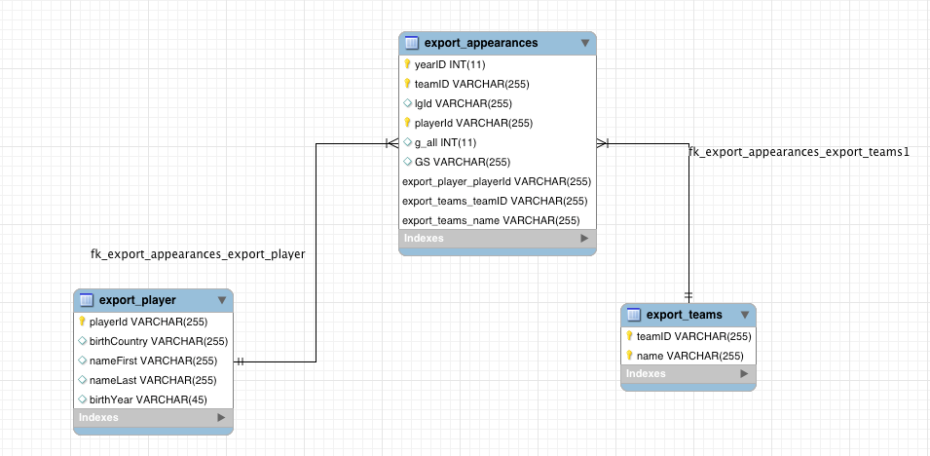
Logical Data Model

Slide 6
Standalone Neo4J Microservice
Export Process
Create tables that are copies of the views
Select table in schema
Right click and choose “Table Data Export Wizard”
Export as CSV.
Files are at https://courseworks2.columbia.edu/courses/47468/files/folder/HW5Input#
Neo4J Import Process
Move CSVs to import subfolder of Neo4j (On Mac = /Users/donaldferguson/Documents/Neo4j/default.graphdb/import)
Connect to Neo4j browser (127.0.0.1:7474/browser/)
Execute LOAD CSV commands

Slide 7
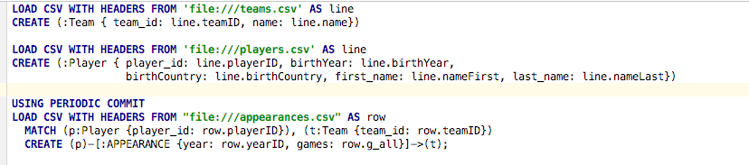
Neo4J LOAD CSV
Statement 1 creates nodes with label :Team for each row in CSV file
Statement 2 creates nodes with label :Player for each row in CSV
Statement 3: For each row in CSV
Find the node (p) :Player that has the row’s playerID
Find the node (t) :Team that has the row’s teamID
Create a relation :APPEARANCE from (p) to (t) with properties year, games to represent the fact that (p) appeared in games games in year year for team (t)

Slide 8
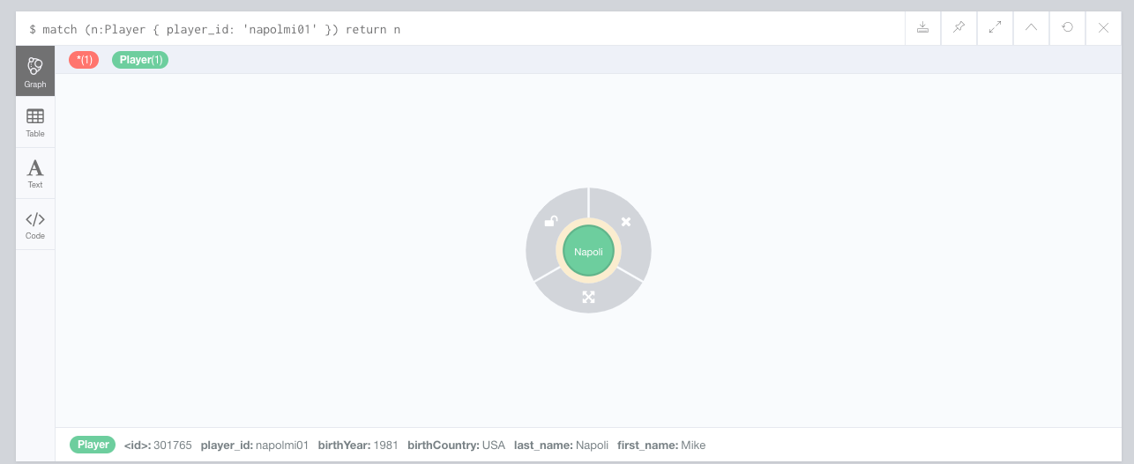
Find Player with player_id ‘napolmi01’

Slide 9
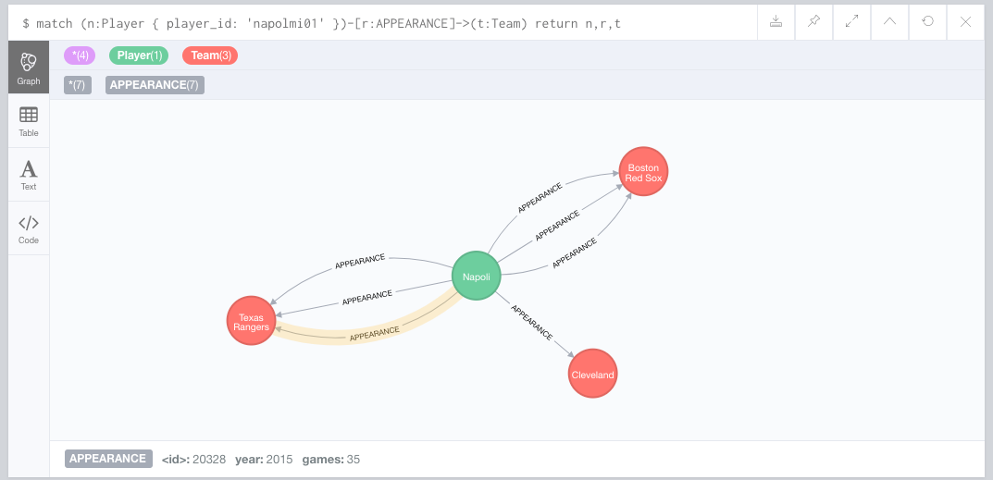
Find the Teams/Years for Which Napoli Appeared

Slide 10
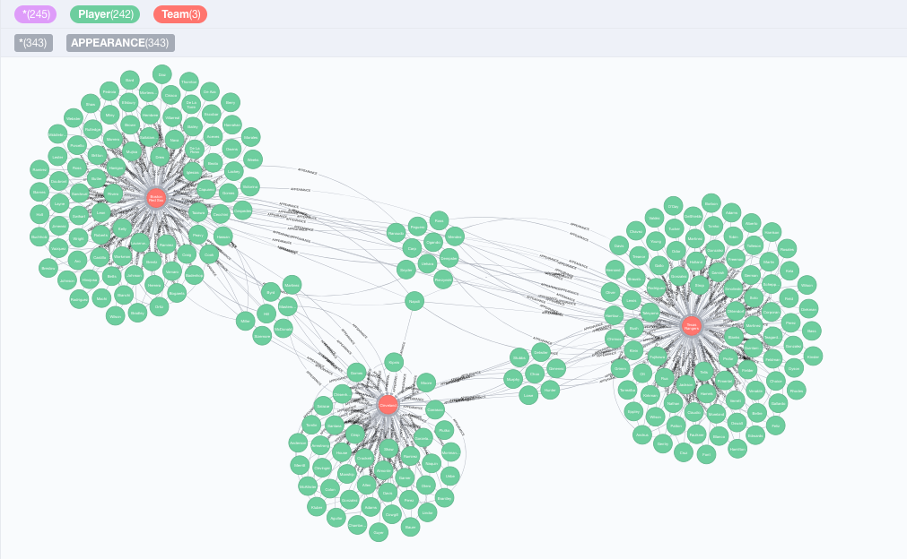
This is Where it Gets Freaky
Players A and B
Were teammates
If
A and B
Both appeared for
Any team T
In the same year.
You will
Write queries to find
All of the teammates of last_name=‘Napoli’
Using Neo4J and SQL

Slide 11
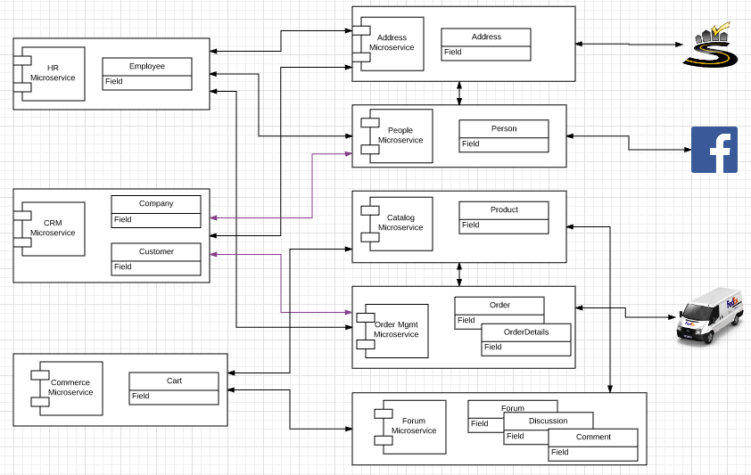
Original Big Picture

Slide 12
0th Project
Teams
Form your teams (approx. 5 people)
Identify contact focal point.
Give your team a “cool” name.
Signup (reuse) and Amazon Web Service Account
Free Tier should be fine.
Provide access to team members.
Create an Elastic Beanstalk instance/application.
Use one of the sample application.
Will have to make more sophisticated starting next week; I will use Node JS with Express for Elastic Beanstalk examples.

Slide 13
1st Project – Part 1
Implement two distinct microservices
Person
Address
Tasks
Use Swagger Editor to define and document REST APIs.
Implement an Elastic Beanstalk application (microservice) for each resource that implements the relevant REST API.
Each microservice should support
GET and POST on resource, e.g. /Person
GET, PUT, DELETE on resource/id, e.g. /Person/dff9
Simple query, e.g. /Person?lastName=Ferguson
Pagination
Relationship paths: /Person/dff9/address and /Addresses/someID/persons
HATEOAS links where appropriate.
Simple HTML/Angular demo UI.
Due: 11:59 PM on 26-Sep-2017

Slide 14
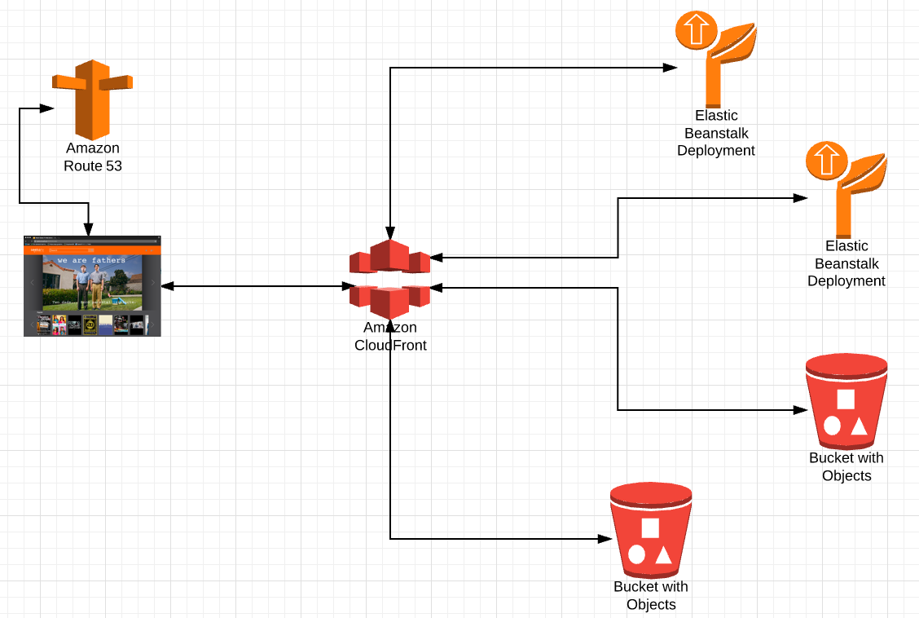
Single Site
DNS
Resolve dff-company.com to
Something.amazon.com
Under the covers
Map
/api/person
/api/address
/app
/js
/views
/app-content
/digital-assets
/images
/videos
To correct IP addresses and sub-paths

Slide 15
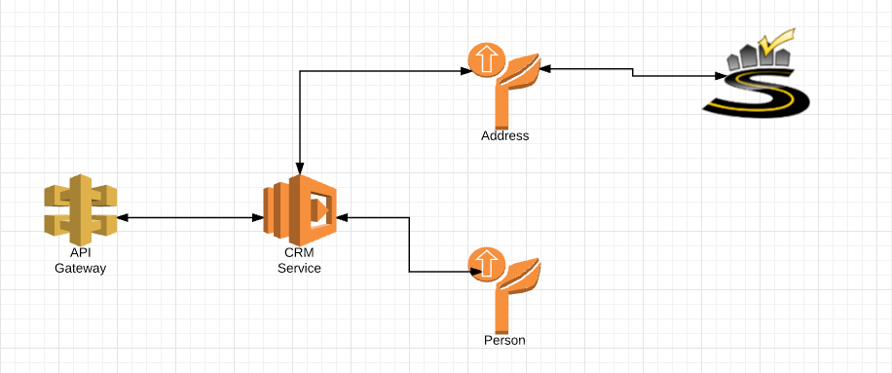
Project 2 – Part 1
Build on 1st to microservices
Implement the CRM Service (and HR Service) using Lambda functions, and orchestration approach from previous lecture.
Integrate with SmartyStreets
Deploy all 3 microservices via API Gateway.
Deliver web content via CloudFront and S3.

Slide 16
Project 2 – Part 2
Implement middleware plugins and microservices implementing
ETag generation and processing.
Idempotent functions.
SNS Event generation on PUT, POST and DELETE.
Plug/deploy the plugin layer in
Each of the Beanstalk Microservices
The CRM Lambda function.
Write an empty, placeholder Lambda function that reacts to the SNS events. We will do some interesting things with this later.

Slide 17
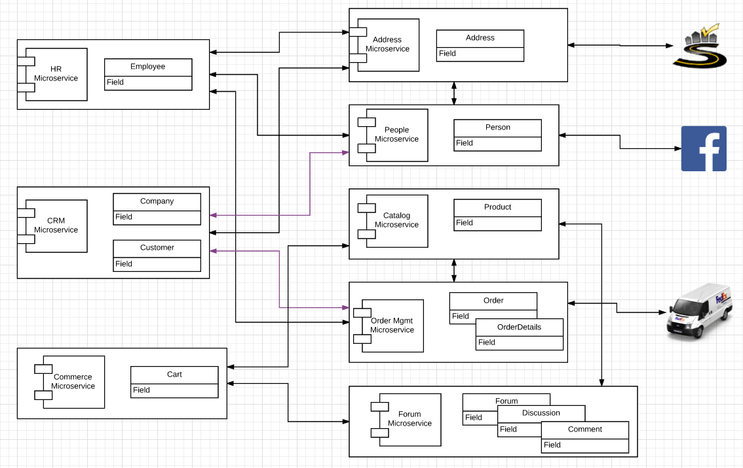
Project 3 4 – Start/Expand Commerce Microservice
Use Lambda function
Customers may
Register with
And subsequently logon with
Facebook or Twitter
Just
Implement register/logon
We will later
Use Step Functions for composing microservices and APIs
Publish commerce actions to FB and Twitter.
Also, write
A placeholder
API Gateway Custom Authorizer
Which we will later use to manager authorization to orders.

Slide 18
Last Week’s Lecture – CAP and New Datamodels
The initial idea was
DynamoDB for the forum
Neo4J to track/query
Who bought what?
Who has bought things similar to whom?
Who commented on what?
etc.
Use Redis to optimize
Idempotency
Etag
But
we do not have enough time to do in context of solution.
Will have to do smaller scenarios and use cases.

Slide 19
My View on Status
Project | Subtask | Element
Project 0 | Set up team Run ELB
Project 1 | Implement 2 microservices | Implement REST API/HATEOAS Query, relationships
 | Swagger | Document, test Integrate with API GW, development tools, …
Project 2 | Cloud APIs | SmartyStreets (UI, backend)
 | Orchestration | In code
 | Single Site Image | S3 for content CloudFront API Gateway
 | Middleware | ETag and idempotency technical microservice SNS event generation
Project 3 | OAuth2 | Logon, Register Custom API GW Authorizer → Authorization
Additional Goals |  | Step functions SNS to integrate registration, commerce views, etc. with Neo4J SNS → Swagger via WebHooks/Lambda Redis: Optimize data sharing for middleware scenarios Rules engines Text search

Slide 20
Timetable
Project 2 and project 3
Complete (initial) reviews by 05-Dec.
Use 27-Nove and 05-Dec lectures if possible, then office hours, then extra OH.
We will hold one final project review with each team
Covering all elements of projects 1, 2 and 3
Including modification/correction based on feedback from prior reviews.
I will provide a list of completion requirements metrics.
Project 4, which has two small subelements
Simple idempotency check microservice → Redis
POST token returns OK if token not previously seen.
POST returns error if token previously recorded.
Simple graph microservice on Neo4J using sample data.
POST a simple query command in JSON.
Returns results from Neo4J.

Slide 21
Graph Database

Slide 22
Graph Database
Exactly what it sounds like
Two core types
Node
Edge (link)
Nodes and Edges have
Label(s) = “Kind”
Properties (free form)
Query is of the form
p1(n)-p2(e)-p3(m)
n, m are nodes; e is an edge
p1, p2, p3 are predicates on labels

Slide 23
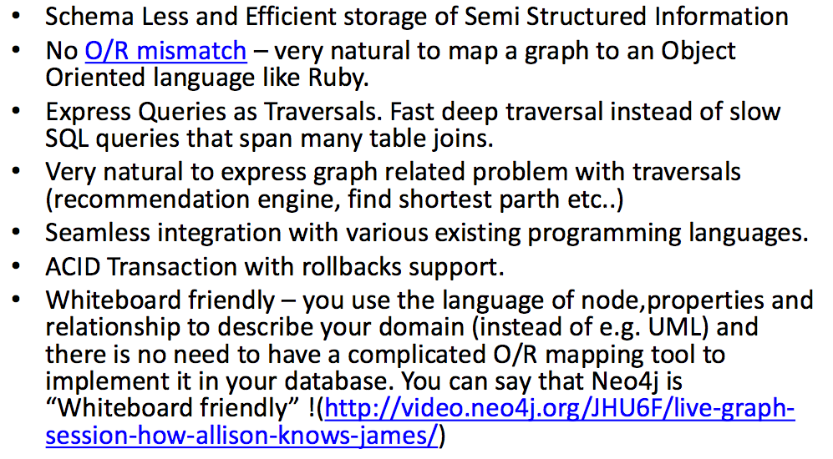
Why Graph Databases? (https://www.slideshare.net/debanjanmahata/an-introduction-to-nosql-graph-databases-and-neo4j)

Slide 24
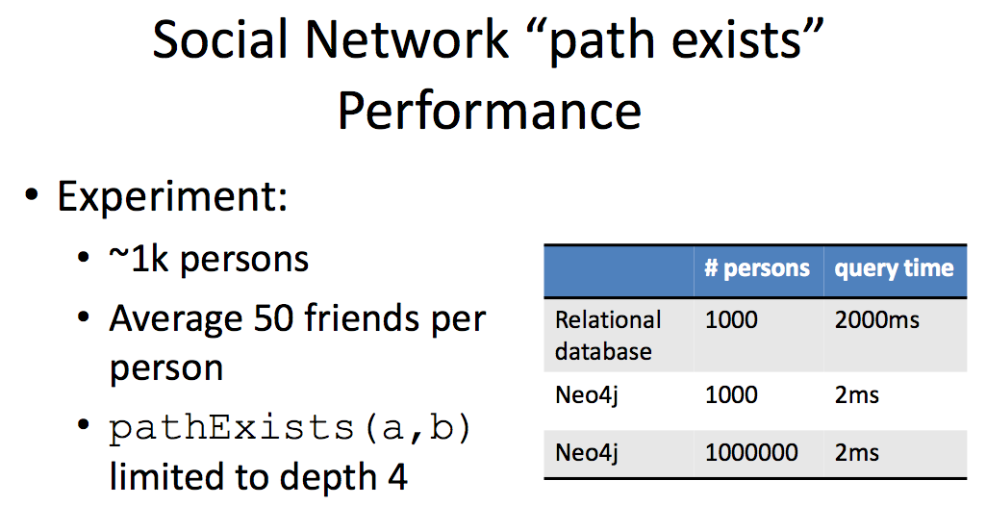
Graph databases are
Extremely fast for some queries and data models.
Implement a language that vastly simplifies writing queries.

Slide 25
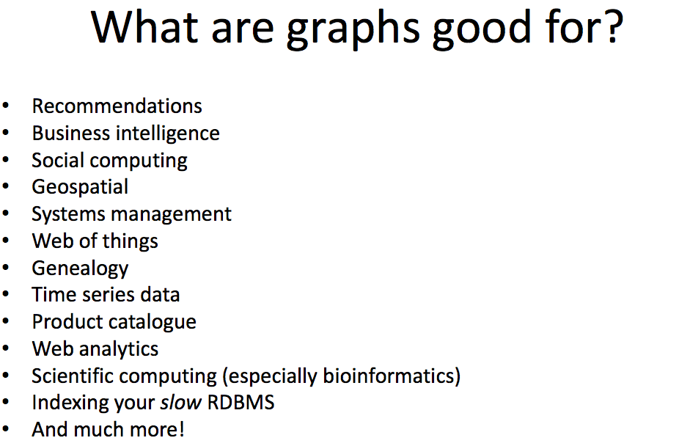

Slide 26
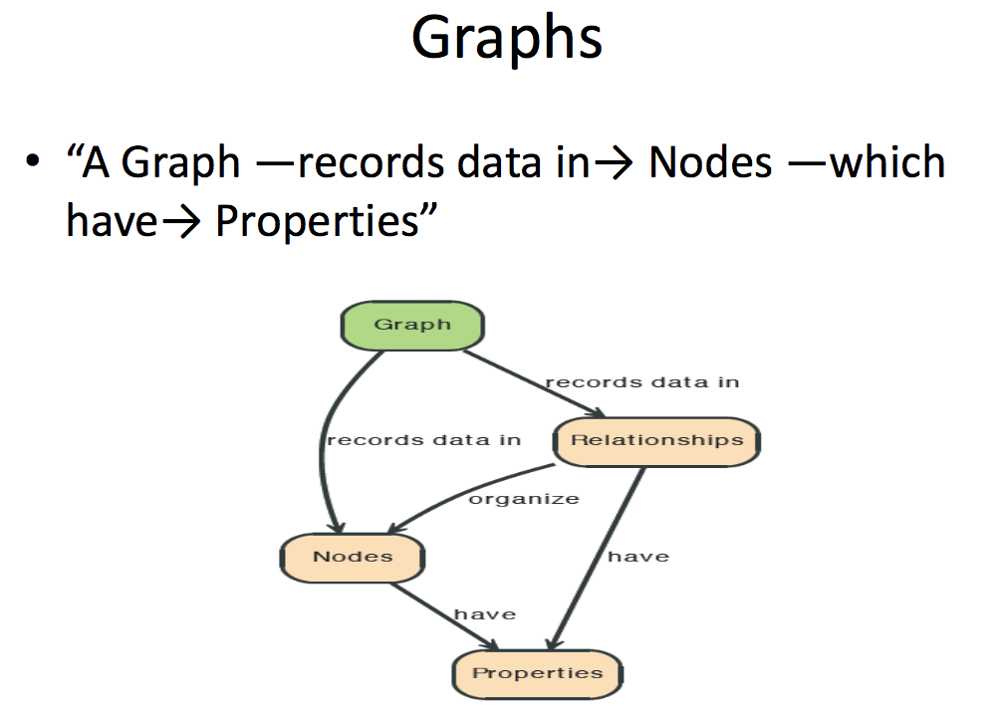

Slide 27
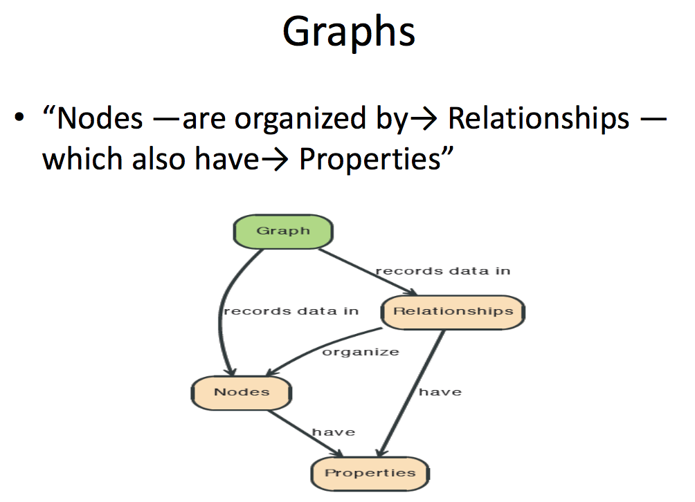

Slide 28
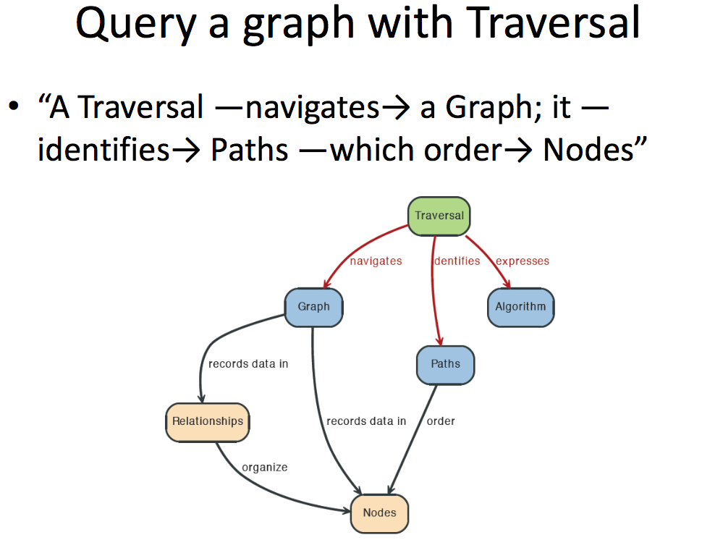

Slide 29
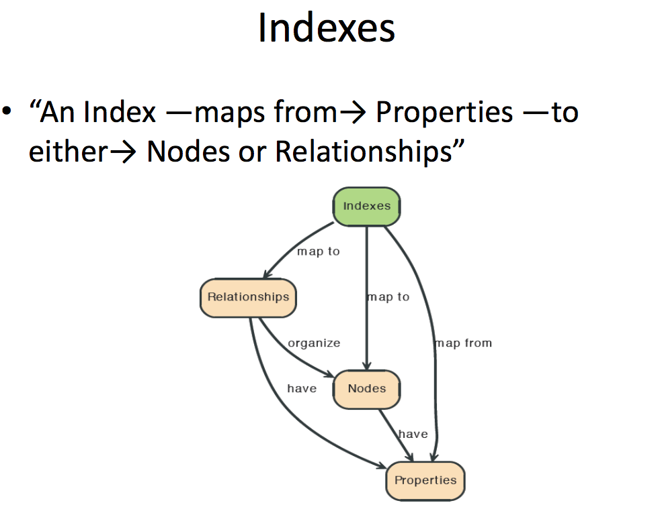

Slide 30
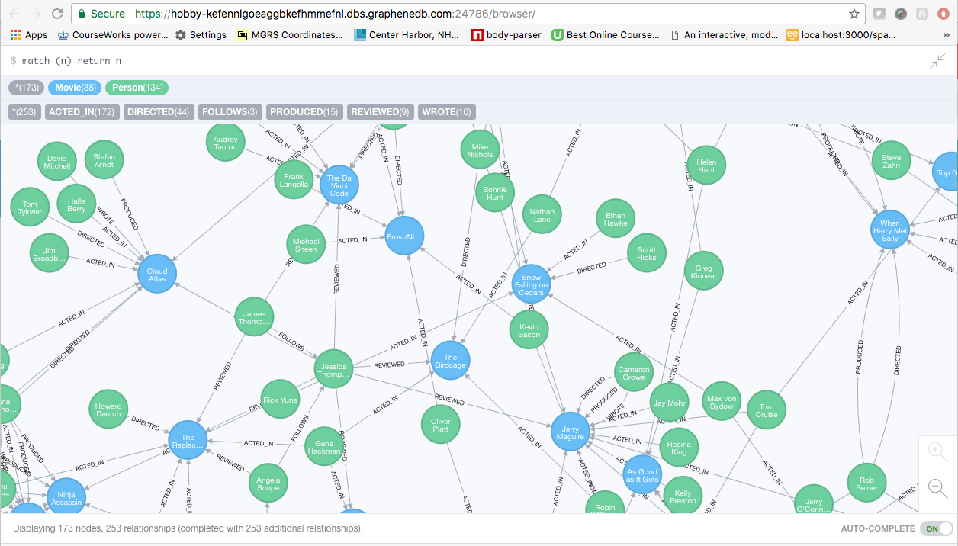
A Graph Database (Sample)

Slide 31
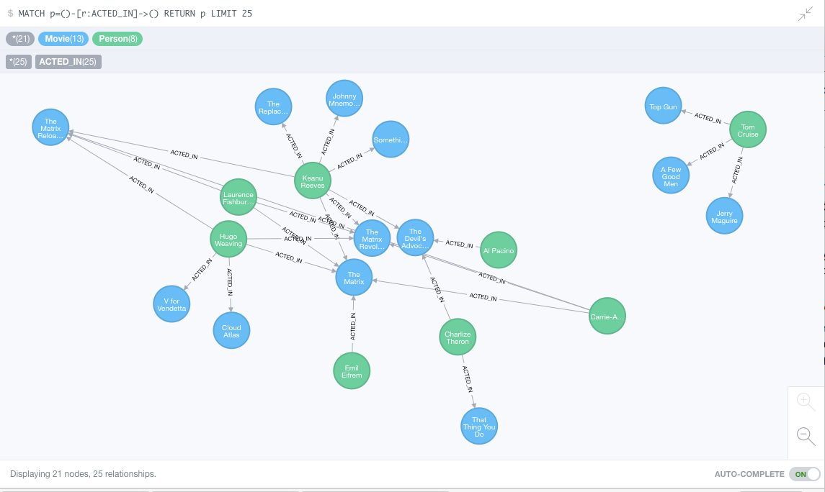
Neo4J Graph Query
Who acted in which movies?

Slide 32
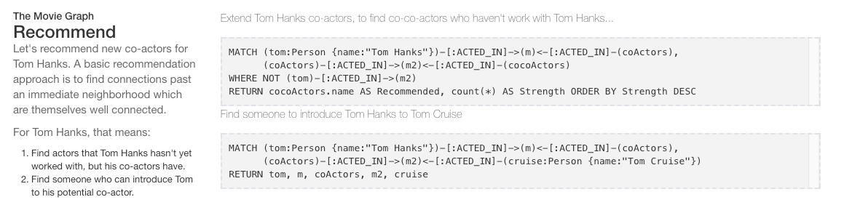
Big Deal. That is just a JOIN.
Yup. But that is simple.
Try writing the queries below in SQL.

Slide 33
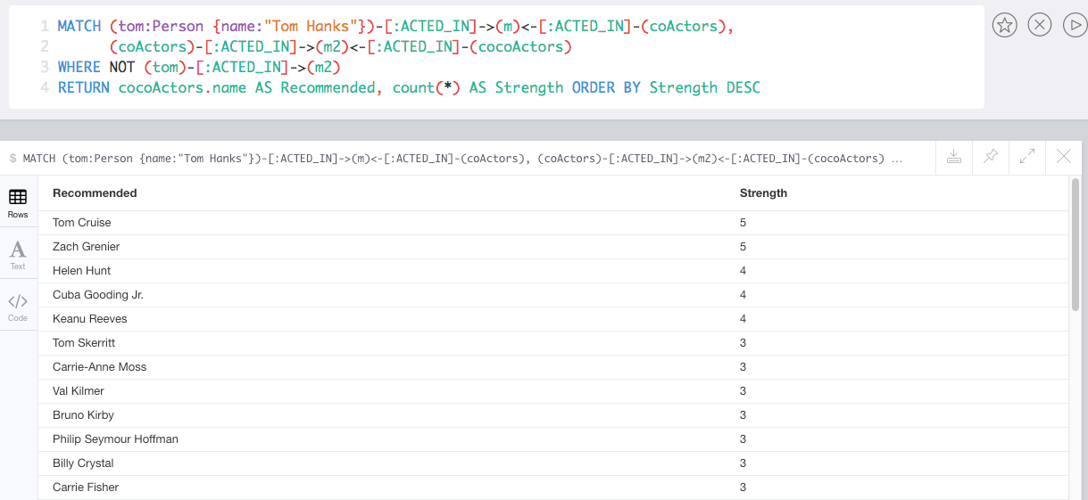

Slide 34
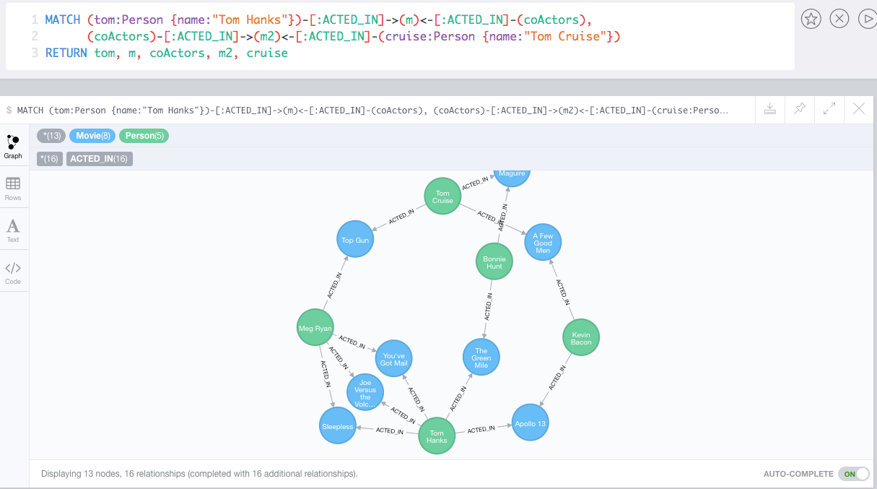
Which actors have worked with both Tom Hanks and
Tom Cruise?

Slide 35
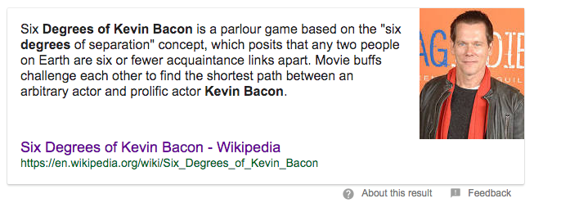
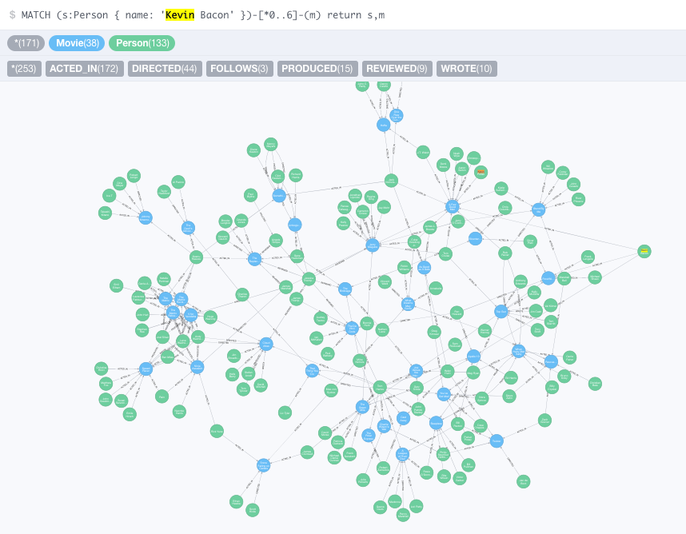
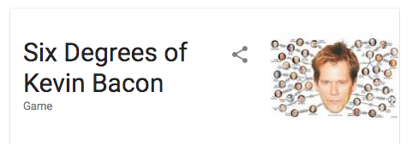

Slide 36
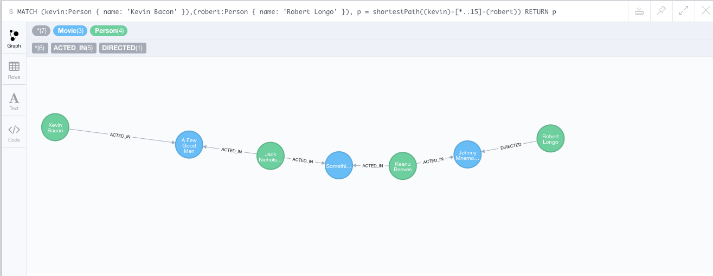
How do you get from Kevin Bacon to
Robert Longo?

Slide 37
Redis

Slide 38



Redis
Redis Key-Value Database:
Practical Introduction
SoftUni Team
Technical Trainers
Software University
http://softuni.bg

Slide 39


Table of Contents
What is Redis?
Installing and Running Redis
Redis Commands
String Commands
Working with Keys
Working with Hashes
Working with Lists
Working with Sets
Working with Sorted Sets

Slide 40

Redis
Ultra-Fast Data Structure Server

Slide 41
What is Redis?
Redis is:
Ultra-fast in-memory key-value data store
Powerful data structure server
Open-source software: http://redis.io
Redis stores data structures:
Strings, lists, hashes, sets, sorted sets
Publish / subscribe messaging

Slide 42

Redis: Features
Redis is really fast
Non-blocking I/O, single threaded
100,000+ read / writes per second
Redis is not a database
It complements your existing data storage layer
E.g. StackOverflow uses Redis for data caching
For small labs Redis may replace entirely the database
Trade performance for durability → data is persisted immediately

Slide 43
Installing Redis
To install Redis on Linux / Mac OS X:
Download from http://redis.io/download
Install it and run it
To install Redis on Windows:
Download https://github.com/MSOpenTech/redis
Compile the solution in the msvs folder and build it with VS
The easier way: use the Windows package manager Chocolatey
http://chocolatey.org
choco install redis

Slide 44
Running Redis
On Linux / Mac OS X start / stop the Redis service
The default Redis port is 6379 (the service name is redis_6379)
On Windows start / stop the "redis" service
Use the console-based (CLI) client or just connect with Telnet:
sudo service redis_6379 start
sudo service redis_6379 stop
sc start redis
sc stop redis
redis-cli
telnet localhost 6379

Slide 45
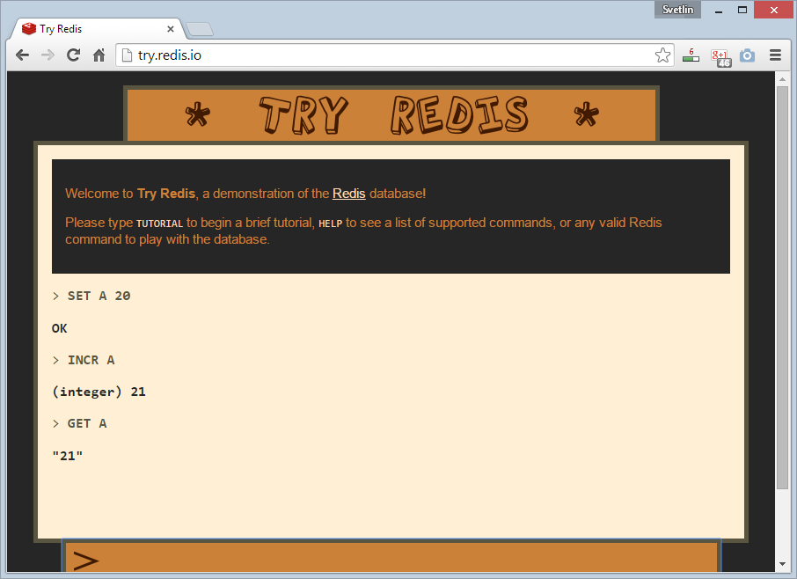
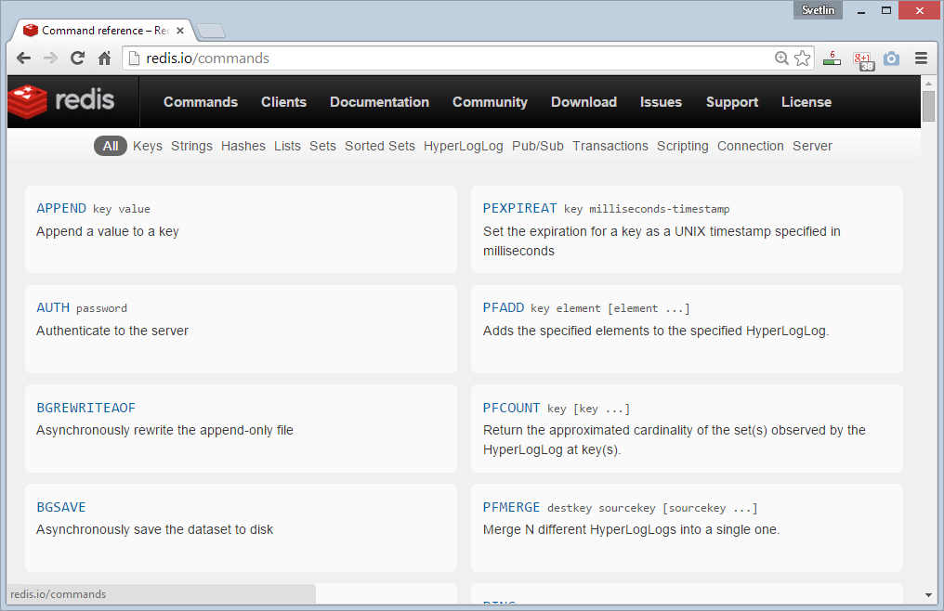
Redis: Basic Commands

Slide 46
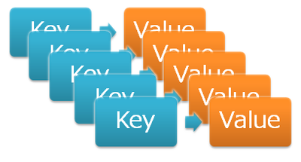
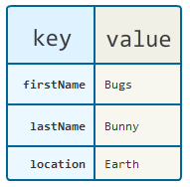
Redis: Data Model
Redis keeps key-value pairs
Every item is stored as key + value
Keys are unique identifiers
Values can be different data structures:
Strings (numbers are stored as strings)
Lists (of strings)
Hash tables: string → string
Sets / sorted sets (of strings)

Slide 47
Redis: Commands
Redis works as interpreter of commands:
SET name "Nakov"
OK
GET name
"Nakov"
DEL name
(integer) 1
GET name
(nil)
Play with the command-line client redis-cli
Or play with Redis online at http://try.redis.io

Slide 48
String Commands
SET [key] [value]
Assigns a string value in a key
GET [key] / MGET [keys]
Returns the value by key / keys
INCR [key] / DECR [key]
Increments / decrements a key
STRLEN [key]
Returns the length of a string
SET name "hi"
OK
GET name
"hi"
SET name abc
OK
GET "name"
"abc"
GET Name
(nil)
SET a 1234
OK
INCR a
(integer) 1235
GET a
"12345"
MGET a name
1) "1235"
2) "asdda"
STRLEN a
(integer) 4

Slide 49
Working with Keys
EXISTS [key]
Checks whether a key exists
TYPE [key]
Returns the type of a key
DEL [key]
Deletes a key
EXPIRE [key] [t]
Deletes a key after t seconds
SET count 5
OK
TYPE count
string
EXISTS count
(integer) 1
DEL count
(integer) 1
EXISTS count
(integer) 0
SET a 1234
OK
GET a
"1234"
EXPIRE a 5
(integer) 1
EXISTS a
(integer) 1
EXISTS a
(integer) 0

Slide 50
Working with Hashes (Hash Tables)
HSET [key] [field] [value]
Assigns a value for given field
HKEYS [key]
Returns the fields (keys) is in a hash
HGET [key] [field]
Returns a value by fields from a hash
HDEL [key] [field]
Deletes a fields from a hash
HSET user name "peter"
(integer) 1
HSET user age 23
(integer) 1
HKEYS user
1) "name"
2) "age"
HGET user age
"23"
HDEL user age
(integer) 1

Slide 51
Working with Lists
RPUSH / LPUSH [list] [value]
Appends / prepend an value to a list
LINDEX [list] [index]
Returns a value given index in a list
LLEN [list]
Returns the length of a list
LRANGE [list] [start] [count]
Returns a sub-list (range of values)
RPUSH names "peter"
(integer) 1
LPUSH names Nakov
(integer) 1
LINDEX names 0
"Nakov"
LLEN names
(integer) 2
LRANGE names 0 100
1) "Nakov"
2) "peter"

Slide 52
Working with Sets
SADD [set] [value]
Appends a value to a set
SMEMBERS [set]
Returns the values from a set
SREM [set] [value]
Deletes a value form a set
SCARD [set]
Returns the stack size (items count)
SADD users "peter"
(integer) 1
SADD users "peter"
(integer) 0
SADD users maria
(integer) 1
SMEMBERS users
1) "peter"
2) "maria"
SREM users maria
(integer) 1

Slide 53
Working with Sorted Sets
ZADD myzset 1 "one"
(integer) 1
ZADD myzset 1 "uno"
(integer) 1
ZADD myzset 2 "two" 3 "three"
(integer) 2
ZRANGE myzset 0 -1 WITHSCORES
1) "one"
2) "1"
…
Learn more at http://redis.io/commands#sorted_set

Slide 54
Publish / Subscribe Commands
First user subscribes to certain channel "news"
Another user sends messages to the same channel "news"
Learn more at http://redis.io/commands#pubsub
SUBSCRIBE news
1) "subscribe"
2) "news"
3) (integer) 1
PUBLISH news "hello"
(integer) 1

Slide 55
Using Redis as a Database
Special naming can help using Redis as database
Add a user "peter".
SADD users:names peter
HSET users:peter name "Peter Petrov"
HSET users:peter email "pp@gmail.com"
SADD users:names maria
HSET users:maria name "Maria Ivanova"
HSET users:maria email "maria@yahoo.com"
SMEMBERS users:names
HGETALL users:peter
Use "users:peter" as key to hold user data
Add a user "maria".
List all users
List all properties for user "peter"

Slide 56


Summary
Redis is ultra-fast in-memory data store
Not a database, used along with databases
Supports strings, numbers, lists, hashes, sets, sorted sets, publish / subscribe messaging
Used for caching / simple apps
Databases

Slide 57







Redis
https://softuni.bg/courses/databases

Slide 58
License
This course (slides, examples, demos, videos, homework, etc.) is licensed under the "Creative Commons Attribution-NonCommercial-ShareAlike 4.0 International" license
Attribution: this work may contain portions from
"Databases" course by Telerik Academy under CC-BY-NC-SA license

Slide 59





Free Trainings @ Software University
Software University Foundation – softuni.org
Software University – High-Quality Education, Profession and Job for Software Developers
softuni.bg
Software University @ Facebook
facebook.com/SoftwareUniversity
Software University @ YouTube
youtube.com/SoftwareUniversity
Software University Forums – forum.softuni.bg

Slide 60
12 Factor Applications
https://12factor.net/
https://www.slideshare.net/bifer/twelve-factor-apps

Slide 61
The 12 Factors
I. Codebase One codebase tracked in revision control, many deploys II. Dependencies Explicitly declare and isolate dependencies III. Config Store config in the environment IV. Backing Services Treat backing services as attached resources V. Build, release, run Strictly separate build and run stages VI. Processes Execute the app as one or more stateless processes
VII. Port binding Export services via port binding VIII. Concurrency Scale out via the process model IX. Disposability Maximize robustness with fast startup and graceful shutdown X. Dev/prod parity Keep development, staging, and production as similar as possible XI. LogsTreat logs as event streams XII. Admin processes Run admin/management tasks as one-off processes

